Slide 1


Slide 2


I am a statistic

Slide 3
Over 100 million students hate math

Slide 5
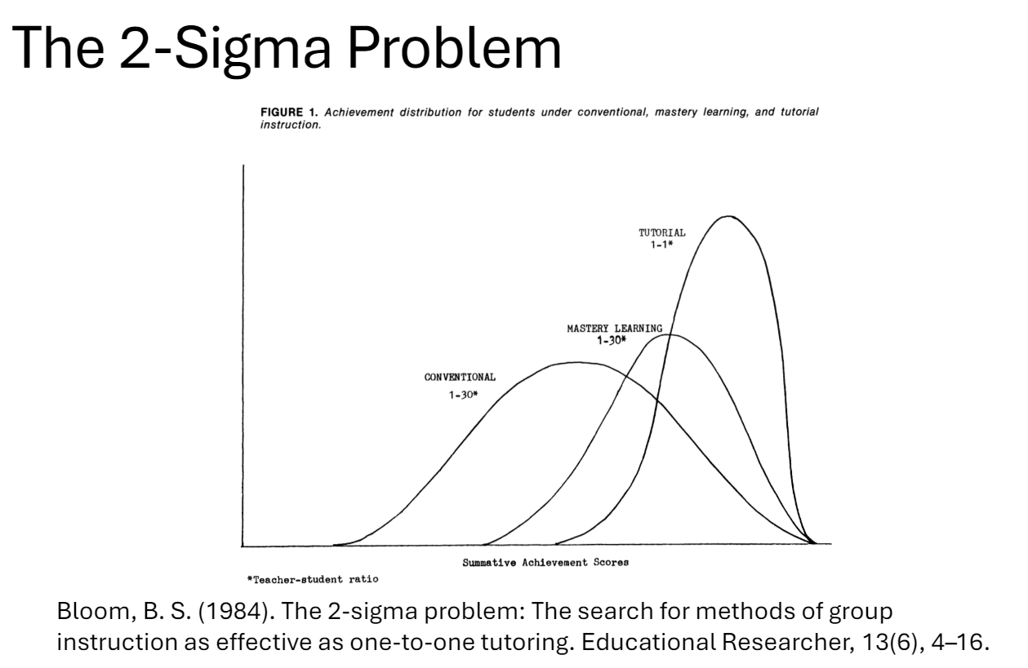

Slide 6
Bloom found that one-to-one tutoring led to a "2-sigma" improvement, with students performing 2 standard deviations better than those using conventional methods.

Slide 7
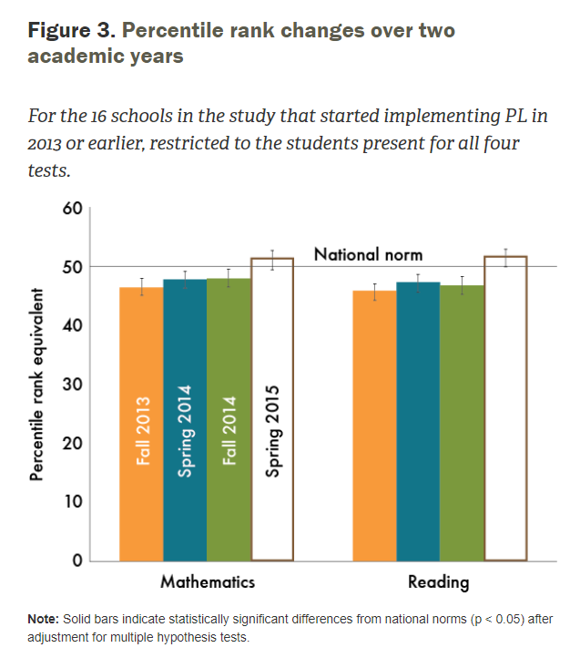
Bloom found that one-to-one tutoring led to a "2-sigma" improvement, with students performing 2 standard deviations better than those using conventional methods.

Slide 8
I am a statistic

Slide 9

Minervans Q-Hack Microsoft Challenge Presentation
MATHY CO

Slide 10
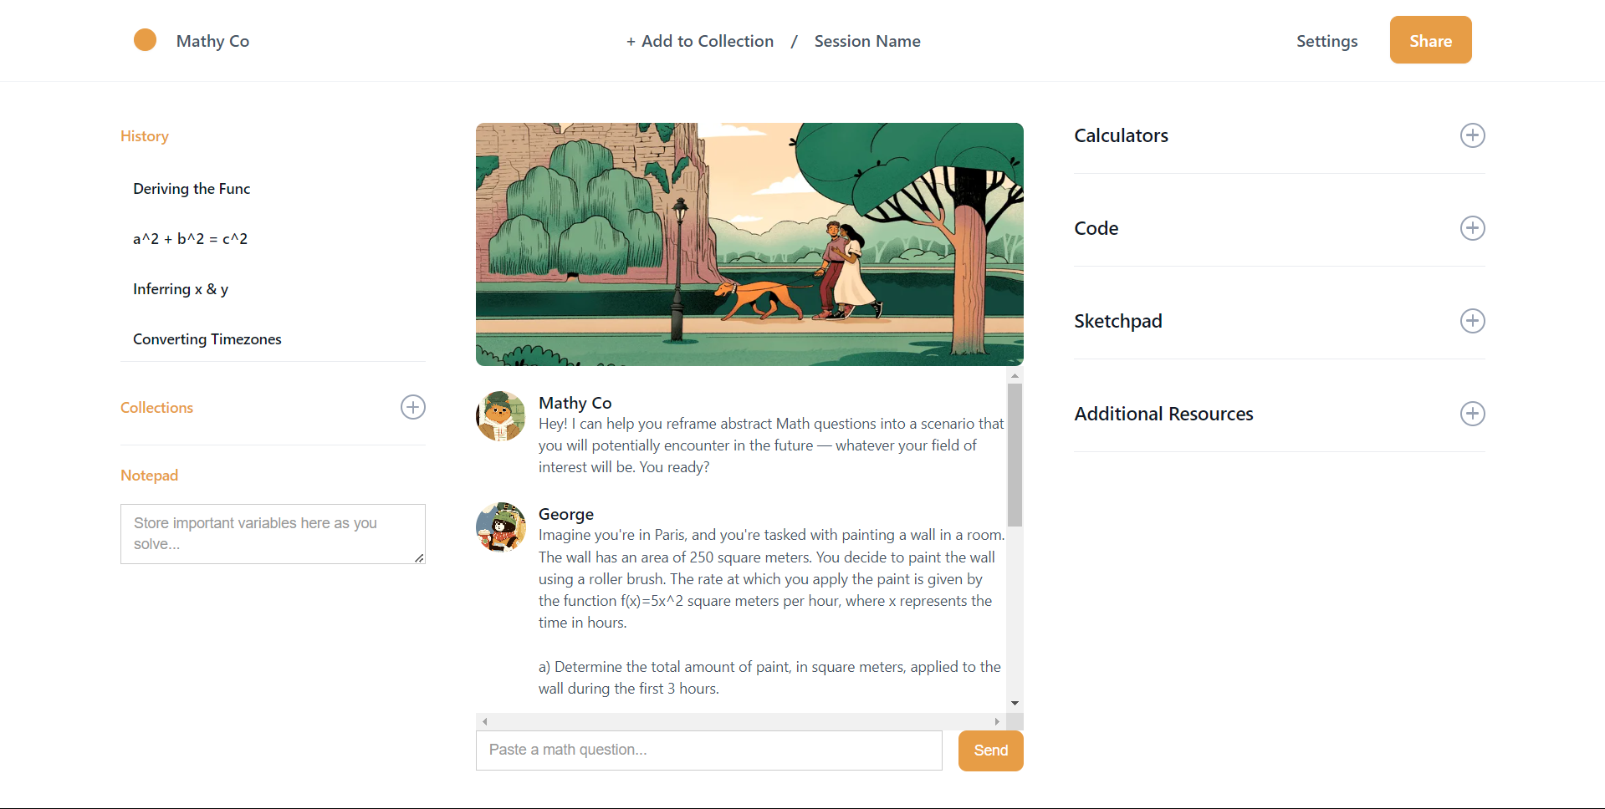

Slide 11




WHY?
SCIENCE OF LEARNING
Attention Span
Personalized Learning
Desired Difficulty

Slide 12

TECHNICALITIES

Slide 13

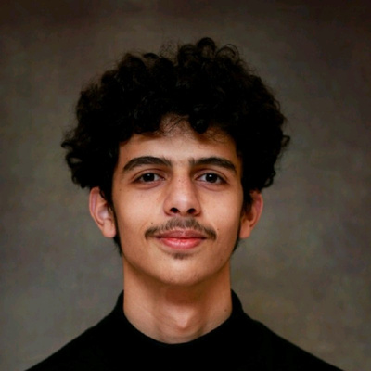

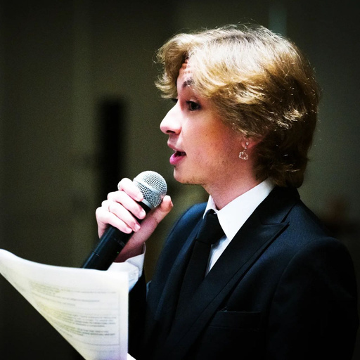



The creators of Mathy Co
The revolution of Loving Mathematics
George Ishaq
Vlad Kramarenko
Enes Akyüz
Carl Kho
Adam
Ajroudi

Slide 14
MATHY CO
THANK YOU

